Slide 1

SPI Flash Parts
Insyde Software March 2021

Slide 2
Copyright 2021 Insyde Software Corp., All Rights Reserved.
No part of this publication may be reproduced, transmitted, transcribed, stored in a retrieval system, or translated into any language or computer language, in any form, or by any means, electronic, mechanical, magnetic, optical, chemical, manual or otherwise, without the prior written permission of Insyde Software Corp.
Disclaimer
Insyde Software Corp. (“Insyde”), provides this document and the programs "as is" without warranty of any kind, either expressed or implied, including, but not limited to, the implied warranties of merchantability or fitness for a particular purpose.
This document may contain technical inaccuracies or typographical errors. Changes are periodically made to the information herein; these changes will be incorporated in future revisions of this document. Insyde is under no obligation to notify any person of the changes. Some code names featured in this document are used to identify products that are in development and not yet publicly announced for release. Insyde is not obligated for its accuracy or completeness.
This document may contain third party’s information, features, schedules, code names, and product names, which are based on Insyde’s interpretation available as of the creation of this document and may be changed from time to time. Neither Insyde nor the third party is obligated to notify such change. If you are interested in third party’s information, you may contact the local third party sales office or the local distributor to obtain the latest specifications. All the intellectual property right of any third party information remains to its owner or steward.

Slide 3
Agenda
Goals & Target Audience
Related Files
Customization Steps
Internal Use

Slide 4
Goals & Target Audience

Slide 5
Goals & Target Audience
Target Audience:
BIOS developers who use InsydeH2O 5.4 (EDK II) to create their firmware products.
Goals:
Know how to support a new SPI flash device in InsydeH2O 5.4.
Requirements:
InsydeH2O 5.4 source code
SPI device datasheet

Slide 6
Related Files

Slide 7
Related Files
Insyde/InsydeModulePkg/Include/Library/FdSupportLib.h
Insyde/InsydeModulePkg/Include/Library/SpiAccessLib.h
Insyde/InsydeFlashDevicePkg/Include/Library/H2OFlashLib.h
Insyde/InsydeFlashDevicePkg/Include/SpiFlashDevice.h
Insyde/InsydeFlashDevicePkg/Library/FlashDevicesLib/FlashDevicesLib.inf
Board/Intel/$(PROJECT_PKG)/Project.dec
Board/Intel/$(PROJECT_PKG)/Project.dsc

Slide 8

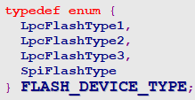


FLASH_DEVICE
Insyde/InsydeModulePkg/Include/Library/FdSupportLib.h

Slide 9
FLASH_DEVICE
Insyde/InsydeFlashDevicePkg/InsydeFlashDevicePkg.dsc

Slide 10
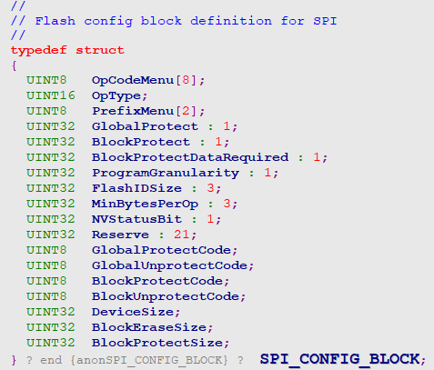
SPI_CONFIG_BLOCK
Insyde/InsydeModulePkg/Include/Library/SpiAccessLib.h

Slide 11
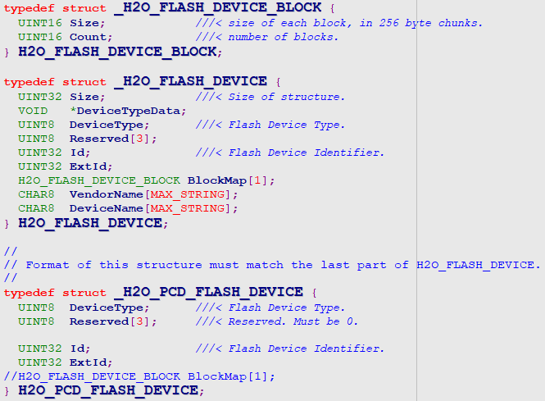
H2O_PCD_FLASH_DEVICE & H2O_FLASH_DEVICE
Insyde/InsydeFlashDevicePkg/Include/Library/H2OFlashLib.h

Slide 12
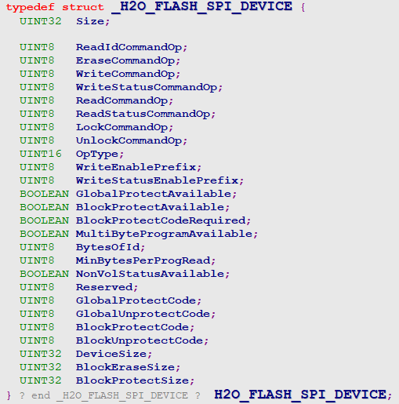
H2O_FLASH_SPI_DEVICE
Insyde/InsydeFlashDevicePkg/Include/SpiFlashDevice.h

Slide 13
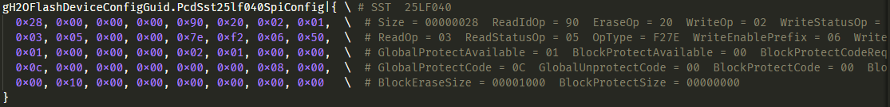
H2O_FLASH_SPI_DEVICE
Insyde/InsydeFlashDevicePkg/InsydeFlashDevicePkg.dsc

Slide 14
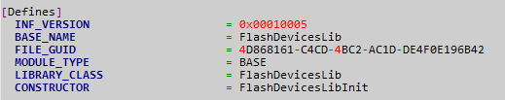
H2O_FLASH_SPI_DEVICE
Insyde/InsydeFlashDevicePkg/Library/FlashDevicesLib/FlashDevicesLib.inf

Slide 15
FlashDeviceLib – Library Instance
Insyde/InsydeFlashDevicePkg/Library/FlashDevicesLib/FlashDevicesLib.c
FlashDevicesLib.c
FlashDevicesLib.c
EFI_STATUS
EFIAPI
FlashDevicesLibInit (
VOID
)
{
DetectH2OFlashDevice();
return EFI_SUCCESS;
}
H2O_FLASH_DEVICE *
DetectH2OFlashDevice (
VOID
)
{
…
PcdTokenNumber = PcdGet32 (PcdActiveFlashDeviceId);
if (PcdTokenNumber == 0) {
PcdTokenNumber = LibPcdGetNextToken(&gH2OFlashDeviceGuid, PcdTokenNumber);
…
}
while (PcdTokenNumber) {
…
}
Status = PcdSet32S (PcdActiveFlashDeviceId, (UINT32)PcdTokenNumber);
ASSERT_EFI_ERROR(Status);
return FlashDeviceInstance;
}

Slide 16
FlashDeviceLib – Library Instance
Insyde/InsydeFlashDevicePkg/Library/FlashDevicesLib/FlashDevicesLib.c
FlashDevicesLib.c
H2O_FLASH_DEVICE *
DetectH2OFlashDevice (
VOID
)
{
…
while (PcdTokenNumber) {
…
FlashDeviceInstance = RecognizeFlashDeviceByPcdEx (&PcdTokenNumber);
if (FlashDeviceInstance){
break;
}
…
// Rescan flash devices if flash device with PcdActiveFlashDeviceId cannot be recognized
PcdTokenNumber = LibPcdGetNextToken (&gH2OFlashDeviceGuid, PcdTokenNumber);
…
// Skip common spi
if (PcdTokenNumber == COMMON_SPI_TOKEN_NUMBER){
PcdTokenNumber = LibPcdGetNextToken (&gH2OFlashDeviceGuid, PcdTokenNumber);
}
}
…
}

Slide 17
PCD Declaration
Board/Intel/$(PROJECT_PKG)/Project.dec
Project.dec
[PcdsFeatureFlag]
gH2OFlashDeviceEnableGuid.PcdVendorDeviceSpiEnable|TRUE|BOOLEAN|0x00001234
[PcdsDynamicEx]
gH2OFlashDeviceGuid.PcdVendorDeviceSpi|{0}|VOID*|0x00001234
gH2OFlashDeviceMfrNameGuid.PcdVendorDeviceSpiMfrName|"Vendor"|VOID*|0x00001234
gH2OFlashDevicePartNameGuid.PcdVendorDeviceSpiPartName|"Device"|VOID*|0x00001234
gH2OFlashDeviceConfigGuid.PcdVendorDeviceSpiConfig|{0}|VOID*|0x00001234

Slide 18
PCD Customization
Board/Intel/$(PROJECT_PKG)/Project.dsc
Project.dsc
[PcdsFeatureFlag]
gH2OFlashDeviceEnableGuid.PcdVendorDeviceSpiEnable|TRUE
[PcdsDynamicExDefault]
gH2OFlashDeviceGuid.PcdActiveFlashDeviceId|0x00654321
gH2OFlashDeviceMfrNameGuid. PcdVendorDeviceSpiMfrName|“Vendor"
gH2OFlashDevicePartNameGuid. PcdVendorDeviceSpiPartName|“ES001"
gH2OFlashDeviceGuid. PcdVendorDeviceSpi|{ \ # Vendor ES001
0x03, 0x00, 0x00, 0x00, 0x34, 0x12, 0x00, 0x00, \# DeviceType = 03 Id = 00001234
0x00, 0x00, 0x00, 0x00, 0x10, 0x00, 0x80, 0x00 \# ExtId = 00000000 BlockSize = 0010 Multiple = 0080
}
gH2OFlashDeviceConfigGuid. PcdVendorDeviceSpiConfig|{ \ # Vendor ES001
0x28, 0x00, 0x00, 0x00, 0x90, 0x20, 0x02, 0x01, \ # Size = 00000028# ReadIdOp = 90 EraseOp = 20 riteOp = 02 WriteStatusOp = 01
0x03, 0x05, 0x00, 0x00, 0x7e, 0xf2, 0x06, 0x50, \# ReadOp = 03 ReadStatusOp = 05 # OpType = F27E WriteEnablePrefix = 06 WriteStatusEnablePrefix = 50
0x01, 0x00, 0x00, 0x00, 0x02, 0x01, 0x00, 0x00, \# GlobalProtectAvailable = 01 BLockProtectAvailable = 00 # BlockProtectCodeRequired = 00 MultiByteProgramAvailable = 00# BytesOfId = 02 MinBytePerProgRead = 01 NoVolStatusAvailable = 00
…
}

Slide 19
Customization Steps

Slide 20
Customization Steps
Modify Project.dec & Project.dsc
Add following PCDs declaration & customization
gH2OFlashDeviceEnableGuid.PcdVendorDeviceSpiEnable
gH2OFlashDeviceGuid.PcdVendorDeviceSpi
gH2OFlashDeviceMfrNameGuid.PcdVendorDeviceSpiMfrName
gH2OFlashDevicePartNameGuid.PcdVendorDeviceSpiPartName
gH2OFlashDeviceConfigGuid.PcdVendorDeviceSpiConfig
Modify Project.dsc
If the project just support single flash device:
gH2OFlashDeviceGuid.PcdActiveFlashDeviceId

Slide 21
Thanks!

